Slide 1
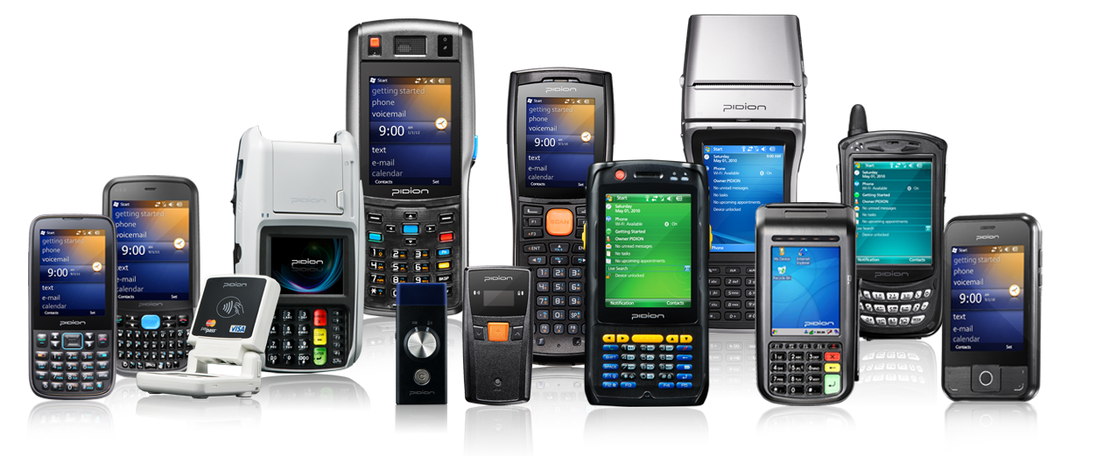
BCM4329 WLAN Device Driver
2012. 6. 20 개발 2그룹 김경호 책임연구원
Copyright © 1995-2012 Bluebird Soft Inc. All Rights Reserved.

Slide 2
WinCE Device Driver
DriverEntry
InitializeHandler
HaltHandler
QueryInformationHandler
SetinformationHandler
ResetHandler
SendPacketHandler
ReturnPacketHandler

Slide 3
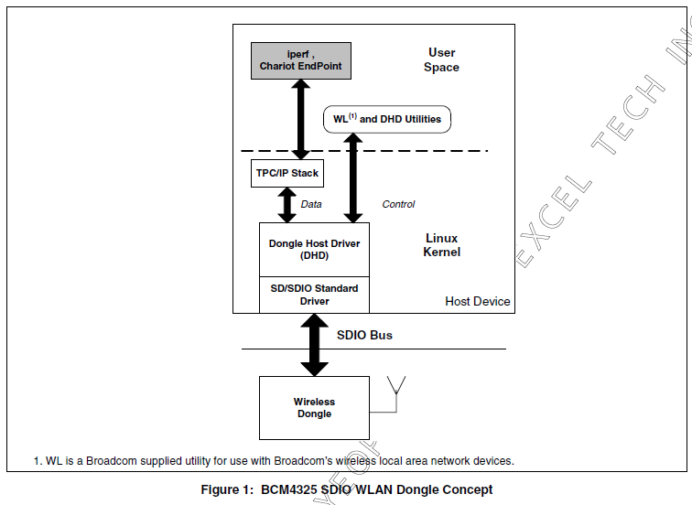
Dongle Concept

Slide 4
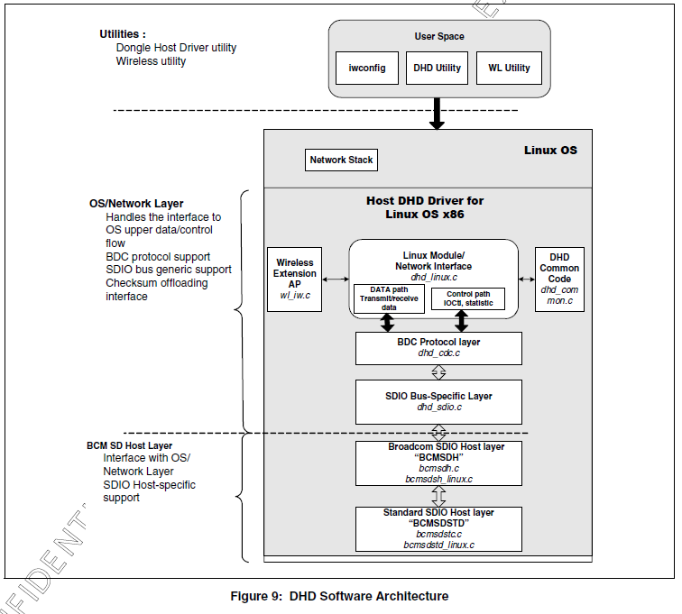
DHD Software Architecture

Slide 5
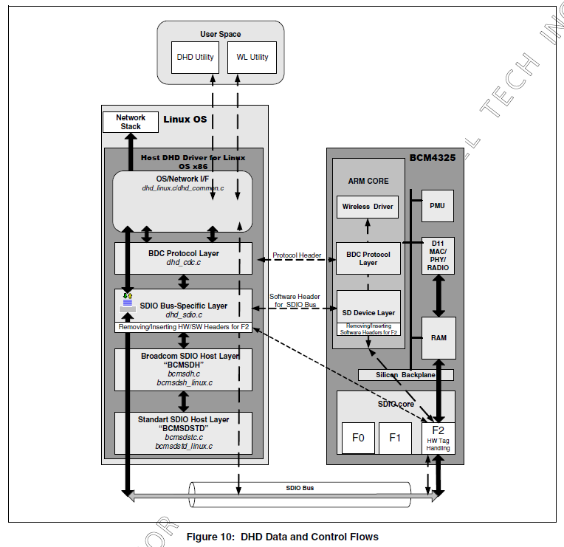
DHD Data and Control Flows

Slide 6
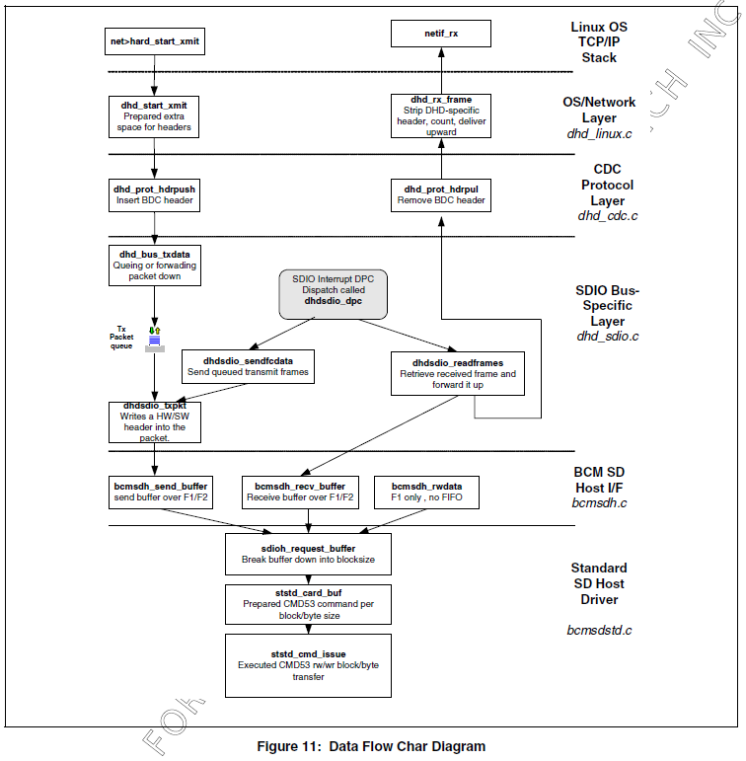
Data Flow Char Diagram

Slide 7
Function Call Flows

Slide 8
BCM4329 vs AR6K
BCM4329 | AR6K
OS / Network Layer (dhd_ndis.c) | OS / Network Layer (host/os/wince/ndis)
CDC Protocol Layer (dhd_cdc.c) | Htc (host/htc2)
SDIO Bus Specific Layer dhd_sdio.c | HIF (host/wince/hif)
BCM SD Host I/F bcmsdh.c

Slide 9
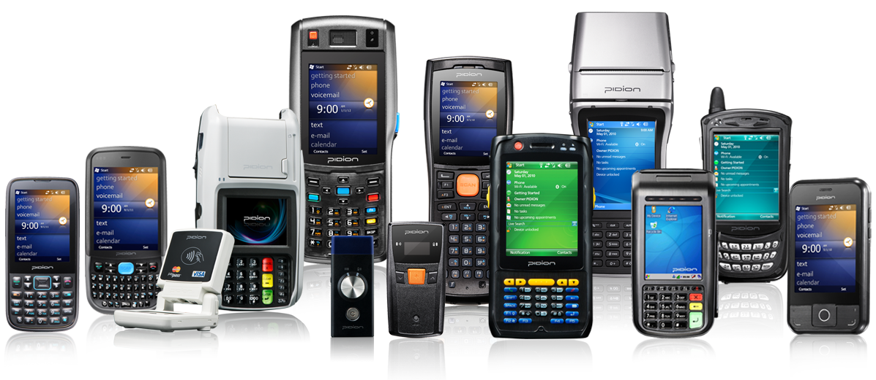
Thank you!

